Slide 1
Lecture 11 Shortest Paths
Zonghua Gu (based on Jianchen Shan)
Department of Computer Science
Hofstra University

Slide 2
Lecture Goals
In this lecture we study shortest-paths problems. We begin by analyzing some basic properties of shortest paths and a generic algorithm for the problem.
We introduce and analyze Dijkstra's algorithm for shortest-paths problems with nonnegative weights.
Next, we consider an even faster algorithm for DAGs, which works even if the weights are negative.
We conclude with the Bellman–Ford–Moore algorithm for edge-weighted digraphs with no negative cycles.
We also consider applications ranging from content-aware fill to arbitrage.

Slide 3
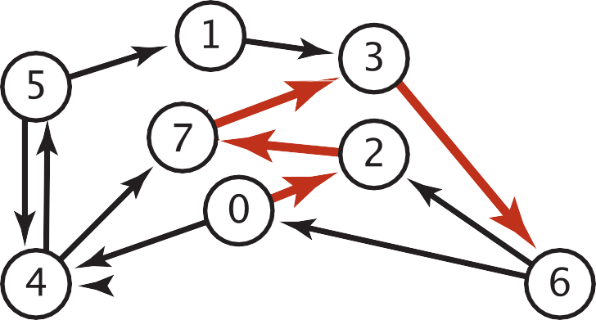
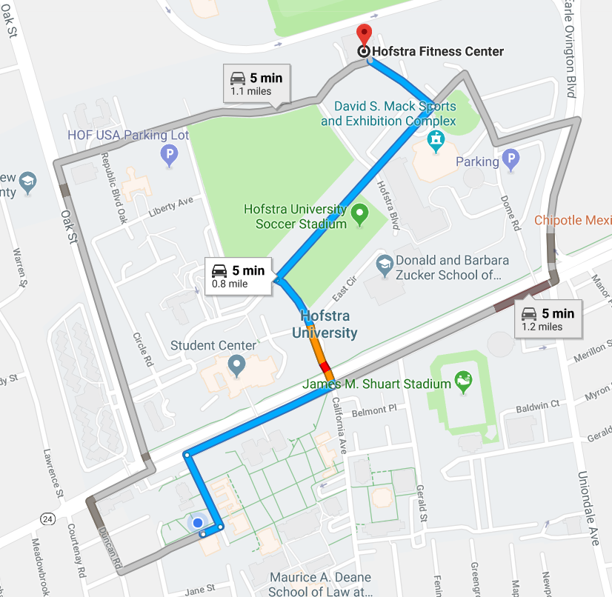

Shortest Paths in an Edge-weighted Digraph
Given an edge-weighted digraph, find the shortest path from s to t.
edge-weighted digraph
shortest path from 0 to 6
0->2 0.26
4->5 | 0.35
5->4 | 0.35
4->7 | 0.37
5->7 | 0.28
7->5 | 0.28
5->1 | 0.32
0->4 | 0.38
0->2 | 0.26
7->3 | 0.39
1->3 | 0.29
2->7 | 0.34
6->2 | 0.40
3->6 | 0.52
6->0 | 0.58
6->4 | 0.93
2->7 | 0.34
7->3 | 0.39
3->6 | 0.52
Variants
Can we use BFS?
Which vertices?
Single source: from one vertex s to every other vertex.
Source-sink: from one vertex s to another t.
All pairs: between all pairs of vertices.
Nonnegative weights?
Cycles?
Negative cycles.
Simplifying assumption: Each vertex is reachable from s.

Slide 4
Weighted Directed Edge API
public class DirectedEdge
DirectedEdge(int v, int w, double weight) //weighted edge v->w
int from() // vertex v
int to() // vertex w
double weight() // the weight
String toString() // string representation
weight
v
w
Idiom for processing an edge e: int v = e.from(), w = e.to();

Slide 5

Weighted Edge: Java Implementation
public class DirectedEdge
{
private final int v, w; private final double weight;
public DirectedEdge(int v, int w, double weight)
{
this.v = v; this.w = w;
this.weight = weight;
}
public int from()
{ return v; }
public int to()
{ return w; }
public int weight()
{ return weight; }
}

Slide 6
Edge-Weighted Graph API
public class EdgeWeightedDigraph
EdgeWeightedDigraph(int V) // edge-weighted digraph with V vertices
void addEdge(DirectedEdge e) // add weighted directed edge e
Iterable <DirectedEdge> adj(int v) // edges pointing from v
Iterable <DirectedEdge> edges() // all edges in this graph
int V() // number of vertices
int E() // number of edges
String toString() // string representation
0 | 2 | .26 | →
0 | 1 | .38
adj
0
1
2
3
4
1 | 3 | .29
2 | 4 | .34
reference to a
DirectedEdge
object
3 | 2 | .52
4 | 2 | .26 | →
4 | 0 | .35

Slide 7

Edge-Weighted Digraph: Adjacency-Lists Implementation
public class EdgeWeightedDigraph
{
private final int V;
private final List<DirectedEdge>[] adj;
public EdgeWeightedDigraph (int V)
{
this.V = V;
adj = (List<DirectedEdge>[]) new ArrayList[V];
for (int v = 0; v < V; v++)
adj[v] = new ArrayList<DirectedEdge>();
}
public void addEdge(DirectedEdge e)
{
int v = e.from();
adj[v].add(e);
}
add edge e = v->w to only v’s adjacency lists
public Iterable<DirectedEdge> adj(int v)
{ return adj[v]; }
}

Slide 8

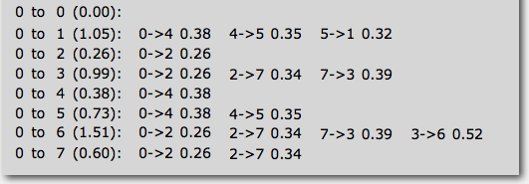
Single-source Shortest Paths API
Goal. Find the shortest path from s to every other vertex.
public class SP
SP(EdgeWeightedGraph G, int s) // shortest paths from s in graph G
double distTo(int v) // length of shortest path from s to v
Iterable <DirectedEdge> pathTo(int v) // shortest path from s to v
SP sp = new SP(G, s);
for (int v = 0; v < G.V(); v++)
{
StdOut.printf("%d to %d (%.2f): ", s, v, sp.distTo(v));
for (DirectedEdge e : sp.pathTo(v)) {
StdOut.print(e + " ");
StdOut.println();
}
}

Slide 9
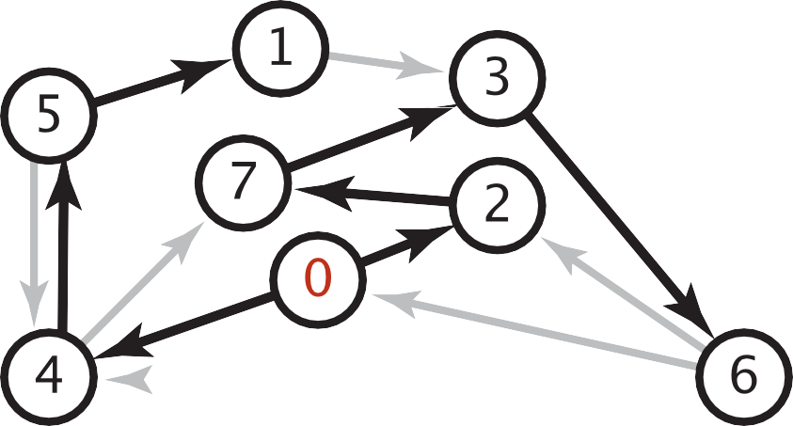

Data Structures for Single-source Shortest Paths
Goal. Find the shortest path from s to every other vertex.
Observation. A shortest-paths tree (SPT) solution exists.
Consequence. Can represent the SPT with two vertex-indexed arrays:
distTo[v] is length of shortest path from s to v.
edgeTo[v] is last edge on shortest path from s to v.
shortest-paths tree from 0
edgeTo[]
distTo[]
public double distTo(int v)
{ return distTo[v]; }
0
1
2
3
4
5
6
7
null 0
5->1 0.32 1.05
0->2 0.26 0.26
7->3 0.37 0.97
0->4 0.38 0.38
4->5 0.35 0.73
3->6 0.52 1.49
2->7 0.34 0.60
public Iterable<DirectedEdge> pathTo(int v)
{
Stack<DirectedEdge> path = new Stack<DirectedEdge>();
for (DirectedEdge e = edgeTo[v]; e != null; e = edgeTo[e.from()])
path.push(e);
return path;
}
parent-link representation

Slide 10

Edge Relaxation
Relax edge e = v→w. (basic of building SPT)
distTo[v] is length of shortest known path from s to v.
distTo[w] is length of shortest known path from s to w.
edgeTo[w] is last edge on shortest known path from s to w.
If e = v→w gives shorter path to w through v, update distTo[w] and edgeTo[w].
edgeTo[w] = v
relax edge v→w
3.1
v
private void relax(DirectedEdge e)
{
int v = e.from(), w = e.to();
if (distTo[w] > distTo[v] + e.weight())
{
distTo[w] = distTo[v] + e.weight(); edgeTo[w] = e;
}
}
1.3
s
w
7.2
black edge are in edgeTo[ ]
distTo[w] = 4.4

Slide 11

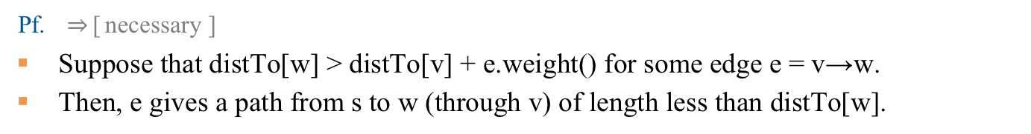
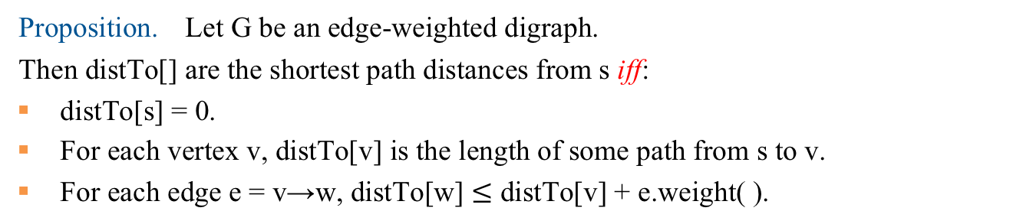
Shortest-paths Optimality conditions
Proposition. Let G be an edge-weighted digraph.
Then distTo[] are the shortest path distances from s iff:
distTo[s] = 0.
For each vertex v, distTo[v] is the length of some path from s to v.
For each edge e = v→w, distTo[w] $≤$ distTo[v] + e.weight( ).
Pf. $⇒$[ necessary ]
Suppose that distTo[w] > distTo[v] + e.weight() for some edge e = v→w.
Then, e gives a path from s to w (through v) of length less than distTo[w].
v
3.1
distTo[v]
1.3
s
w 7.2
distTo[w]

Slide 12
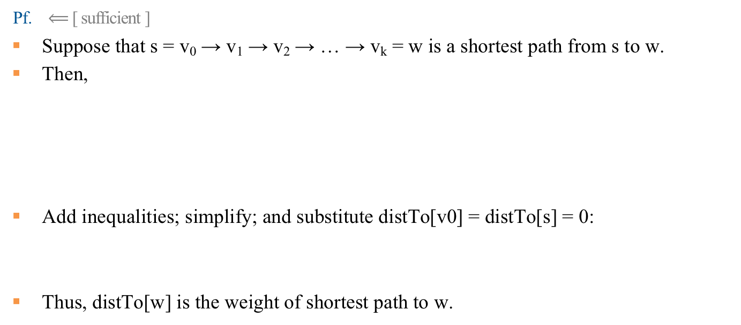
Shortest-paths Optimality conditions
Proposition. Let G be an edge-weighted digraph.
Then distTo[] are the shortest path distances from s iff:
distTo[s] = 0.
For each vertex v, distTo[v] is the length of some path from s to v.
For each edge e = v→w, distTo[w] $≤$ distTo[v] + e.weight( ).
Pf. $⟸$[ sufficient ]
Suppose that s = v₀ → v₁ → v₂ → … → v_{k} = w is a shortest path from s to w.
Then,
Add inequalities; simplify; and substitute distTo[v0] = distTo[s] = 0:
Thus, distTo[w] is the weight of shortest path to w.
distTo[v₁] ≤ distTo[v₀] + e₁.weight( )
distTo[v₂] ≤ distTo[v₁] + e₂.weight( )
……
distTo[v_{k}] ≤ distTo[v_{k-1}] + e_{k}.weight( )
e_{i} = i^{th} edge on shortest path from s to w
distTo[w] = distTo[v_{k}] ≤ e₁.weight( ) + e₂.weight( ) + … + e_{k}.weight( )
weight of shortest path from s to w

Slide 13
Generic Shortest-paths Algorithm
Generic algorithm (to compute SPT from s)
For each vertex v: distTo[v] = ∞.
For each vertex v: edgeTo[v] = null.
distTo[s] = 0.
Repeat until done:
- Relax any edge.
Proposition. Generic algorithm computes SPT (if it exists) from s.
Pf.
Throughout algorithm, distTo[v] is the length of a simple path from s to v (and edgeTo[v] is last edge on path).
Each successful relaxation decreases distTo[v] for some v.
The entry distTo[v] can decrease at most a finite number of times.
Efficient implementations. How to choose which edge to relax?
Ex 1. Dijkstra’s algorithm. (nonnegative weights, directed cycles).
Ex 2. Topological sort algorithm. (no directed cycles).
Ex 3. Bellman–Ford algorithm. (no neigtive cycles).

Slide 14
Dijkstras Shortest Path Algorithm Explained | With Example | Graph Theory

Slide 15
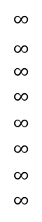
Dijkstra’s Algorithm
choose vertex 5
relax all edges adjacent from 5
choose vertex 2
relax all edges adjacent from 2
choose vertex 3
relax all edges adjacent from 3
choose vertex 6
relax all edges adjacent from 6
Consider vertices in increasing order of distance from s
(non-tree vertex with the lowest distTo[ ] value).
Add vertex to tree and relax all edges pointing from that vertex.
1
v distTo[]
15
3
$$∞$$
$∞$ $∞$
$$∞$$
$$∞$$
$$∞$$
$$∞$$
$$∞$$
0
5
17
20
9
14
29
8
15
17
13
26
14
25
0
1
2
3
4
5
6
7
5
4
12
0
3
8
7
2
7
9
9
5
6
1
5
11
v edgeTo[]
4
4
13
6
0
1
2
3
4
5
6
7
-
-
-
-
-
-
-
-
0
1
1
0
7
4
0
7
2
4
5
5
2
20
choose source vertex 0
relax all edges adjacent from 0
choose vertex 1
relax all edges adjacent from 1
choose vertex 7
relax all edges adjacent from 7
choose vertex 4
relax all edges adjacent from 4
Dijkstras Shortest Path Algorithm Explained | With Example | Graph Theory
https://www.youtube.com/watch?v=bZkzH5x0SKU

Slide 16
Dijkstra’s Algorithm: Correctness Proof
Proposition. Dijkstra's algorithm computes a SPT in any edge-weighted digraph with nonnegative weights.
Pf.
Each edge e = v→w is relaxed exactly once (when v is relaxed),
leaving distTo[w] ≤ distTo[v] + e.weight().
Inequality holds until algorithm terminates because:
distTo[w] cannot increase
distTo[v] will not change
Thus, upon termination, shortest-paths optimality conditions hold.
distTo[ ] values are monotone decreasing
we choose lowest distTo[ ] value at each step (and edge weights are nonnegative)

Slide 17

Dijkstra’s Algorithm: Java Implementation
public class DijkstraSP
{
private DirectedEdge [] edgeTo; private double [] distTo;
private MinPQ<Double> pq;
public DijkstraSP(EdgeWeightedDigraph G, int s)
{
edgeTo = new DirectedEdge[G.V()]; distTo = new double[G.V()];
pq = new MinPQ<Double>(G.V());
for (int v = 0; v < G.V(); v++)
distTo[v] = Double.POSITIVE_INFINITY;
distTo[s] = 0.0;
pq.insert(s, 0.0);
while (!pq.isEmpty())
{
int v = pq.delMin();
for (DirectedEdge e : G.adj(v)) relax(e);
}
relax vertices in order of distance from s
}
}

Slide 18

Dijkstra’s Algorithm: Java Implementation
private void relax(DirectedEdge e)
{
int v = e.from(), w = e.to();
if (distTo[w] > distTo[v] + e.weight())
{
distTo[w] = distTo[v] + e.weight(); edgeTo[w] = e;
if (pq.contains(w)) pq.decreaseKey (w, distTo[w]); else pq.insert (w, distTo[w]);
update PQ
}
}

Slide 19
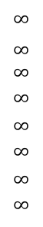
Shortest Paths in Edge-weighted DAG
Suppose that an edge-weighted digraph has no directed cycles. Is it easier to find shortest paths than in a general digraph?
Yes!
Consider vertices in topological order.
Relax all edges pointing from that vertex
v distTo[]
0
1
2
3
4
5
6
7
$$∞$$
$∞$ $∞$
$$∞$$
$$∞$$
$$∞$$
$$∞$$
$$∞$$
0
5
17
20
9
13
29
8
15
17
26
14
25
0 1 4 7 5 2 3 6
1
15
3
5
4
12
0
3
v edgeTo[]
8
7
2
0
1
2
3
4
5
6
7
-
-
-
-
-
-
-
-
0
1
1
0
4
4
0
7
2
5
5
2
7
9
9
5
6
1
5
11
4
4
13
20
6

Slide 20
Shortest Paths in Edge-weighted DAG: Correctness Proof
Proposition. Topological sort algorithm computes SPT in any edge- weighted DAG in time proportional to E + V.
edge weights
can be negative!
Pf.
Each edge e = v→w is relaxed exactly once (when v is relaxed),
leaving distTo[w] ≤ distTo[v] + e.weight().
Inequality holds until algorithm terminates because:
distTo[w] cannot increase
distTo[v] will not change
Thus, upon termination, shortest-paths optimality conditions hold.
distTo[ ] values are monotone decreasing
because of topological order, no edge pointing to v will be relaxed after v is relaxed

Slide 21

Shortest Paths in Edge-weighted DAG: Java Implementation
public class AcyclicSP
{
private DirectedEdge[] edgeTo; private double[] distTo;
public AcyclicSP (EdgeWeightedDigraph G, int s)
{
edgeTo = new DirectedEdge[G.V()]; distTo = new double[G.V()];
for (int v = 0; v < G.V(); v++)
distTo[v] = Double.POSITIVE_INFINITY;
distTo[s] = 0.0;
Topological topological = new Topological(G); for (int v : topological.order())
for (DirectedEdge e : G.adj(v)) relax(e);
topological order
}
}

Slide 22
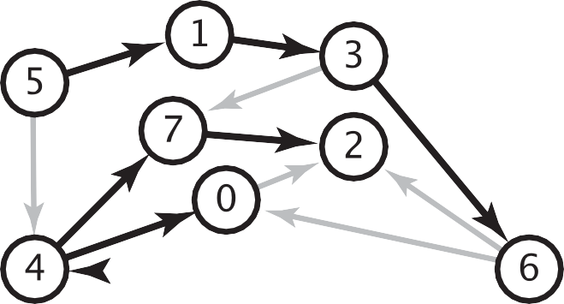
Longest Paths in Edge-weighted DAG
Formulate as a shortest paths problem in edge-weighted DAGs.
Negate all weights.
Find shortest paths.
Negate weights in result.
equivalent: reverse sense of equality in relax()
longest paths input
shortest paths input
5->4 | 0.35 | 5->4 | -0.35
4->7 | 0.37 | 4->7 | -0.37
5->7 | 0.28 | 5->7 | -0.28
5->1 | 0.32 | 5->1 | -0.32
4->0 | 0.38 | 4->0 | -0.38
0->2 | 0.26 | 0->2 | -0.26
3->7 | 0.39 | 3->7 | -0.39
1->3 | 0.29 | 1->3 | -0.29
7->2 | 0.34 | 7->2 | -0.34
6->2 | 0.40 | 6->2 | -0.40
3->6 | 0.52 | 3->6 | -0.52
6->0 | 0.58 | 6->0 | -0.58
6->4 | 0.93 | 6->4 | -0.93
s
Key point. Topological sort algorithm works even with negative weights.

Slide 23
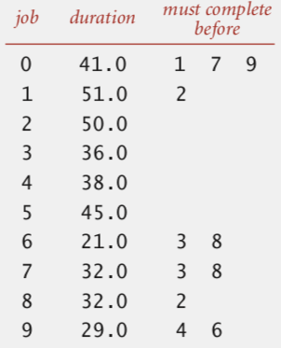
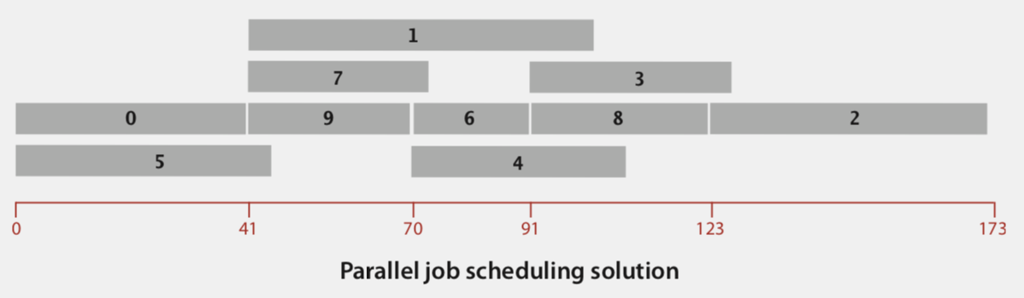
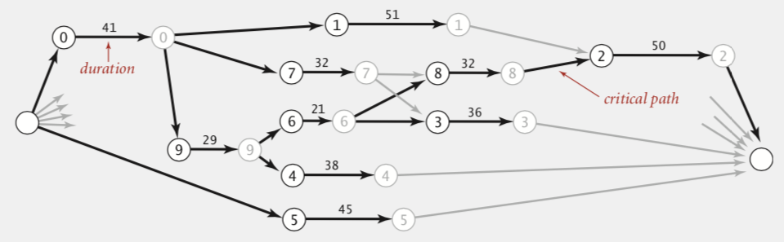
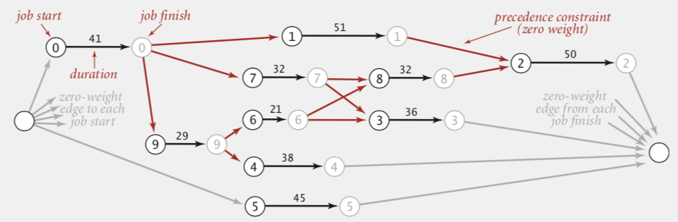
Longest Paths in Edge-weighted DAG: Application
Parallel job scheduling. Given a set of jobs with durations and precedence constraints, schedule the jobs (by finding a start time for each) so as to achieve the minimum completion time, while respecting the constraints.
Critical Path Method. To solve this problem, create edge-weighted DAG:
Source and sink vertices.
Two vertices (begin and end) for each job
Three edges for each job.
begin to end (weighted by duration)
source to begin (0 weight)
end to sink (0 weight)
One edge for each precedence constraint (0 weight).
Use longest path from the source to schedule each job.

Slide 24
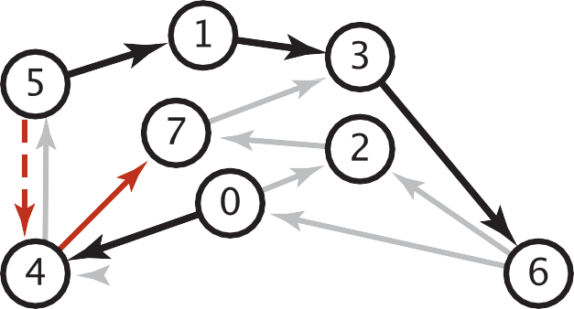
Shortest Paths with Negative weights
Dijkstra. Doesn’t work with negative edge weights.
0
4
1
0
13
1
Conclusion.
Need a different algorithm.
2
6
11
15
3
-9
2
3
0
2
Dijkstra selects vertex 3 immediately after 0. But shortest path from 0 to 3 is 0→1→2→3.
Adding 9 to each edge weight changes the shortest path from 0→1→2→3 to 0→3.
4->5 | 0.35
5->4 | -0.66
4->7 | 0.37
5->7 | 0.28
7->5 | 0.28
5->1 | 0.32
0->4 | 0.38
0->2 | 0.26
7->3 | 0.39
1->3 | 0.29
2->7 | 0.34
6->2 | 0.40
3->6 | 0.52
6->0 | 0.58
6->4 | 0.93
Re-weighting. Add a constant to every edge weight doesn’t work.
A negative cycle is a directed cycle whose sum of edge weights is negative.
A SPT exists iff no negative cycles, assuming all vertices reachable from s
negative cycle (-0.66 + 0.37 + 0.28)
5->4->7->5
shortest path from 0 to 6
0->4->7->5->4->7->5...->1->3->6
Shortest Path Algorithms Explained (Dijkstra's & Bellman-Ford https://www.youtube.com/watch?v=AE5I0xACpZs

Slide 25
Bellman-Ford Algorithm
Bellman–Ford algorithm
For each vertex v: distTo[v] = ∞.
For each vertex v: edgeTo[v] = null.
distTo[s] = 0.
Repeat V-1 times:
- Relax each edge.
for (int i = 1; i < G.V(); i++)
for (int v = 0; v < G.V(); v++)
for (DirectedEdge e : G.adj(v))
relax(e);
pass i (relax each edge)
Bellman-Ford in 5 minutes — Step by step example
https://www.youtube.com/watch?v=obWXjtg0L64

Slide 26
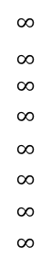
Bellman-Ford Algorithm
Repeat V − 1 times: relax all E edges.
v distTo[]
0
1
2
3
4
5
6
7
$$∞$$
$∞$ $∞$
$$∞$$
$$∞$$
$$∞$$
$$∞$$
$$∞$$
0
5
17
20
9
13
28
8
14
17
26
25
1
15
3
5
4
12
0
3
8
7
2
7
9
v edgeTo[]
9
5
6
1
0
1
2
3
4
5
6
7
-
-
-
-
-
-
-
-
0
1
1
0
4
2
0
5
2
5
2
5
11
4
4
13
20
6
pass 1
pass 2
pass 3
(no further changes)
pass 4-7 (no further changes)
0→1 0→4 0→7 1→2 1→3 1→7 2→3 2→6 3→6 4→5 4→6 4→7 5→2 5→6 7→2 7→5

Slide 27
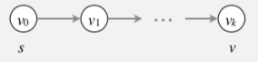
Bellman–Ford Algorithm: Correctness Proof
Proposition. Let s = v₀ → v₁ → v₂ → ... → v_{k} = v be a shortest path from s to v. Then, after pass i, distTo[v_{i}] = d*(v_{i}).
Pf. [ by induction on i ]
Inductive hypothesis: after pass i, distTo[v_{i}] = d*(v_{i}).
Since distTo[v_{i+1}] is the length of some path from s to v_{i+1}, we must have distTo[v_{i+1}] ≥ d*(v_{i+1}).
Immediately after relaxing edge v_{i} → v_{i+1} in pass i+1, we have
distTo[v_{i+1}] ≤ distTo[v_{i}] + weight(v_{i}, v_{i}+1)
= d*(v_{i}) + weight(v_{i}, v_{i+1})
= d*(v_{i+1}).
Thus, at the end of pass i+1, distTo[v_{i+1}] = d*(v_{i+1}).
Corollary. Bellman–Ford computes shortest path distances.
Pf. There exists a shortest path from s to v with at most V – 1 edges.
⇒ ≤ V – 1 passes.
length of shortest path from s to v_{i}

Slide 28
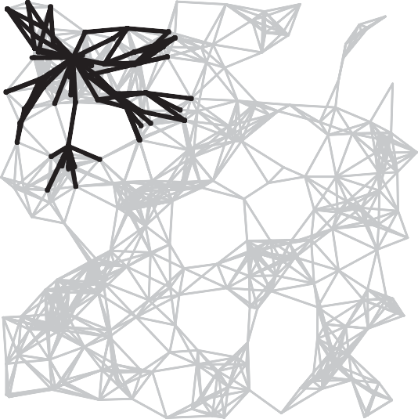
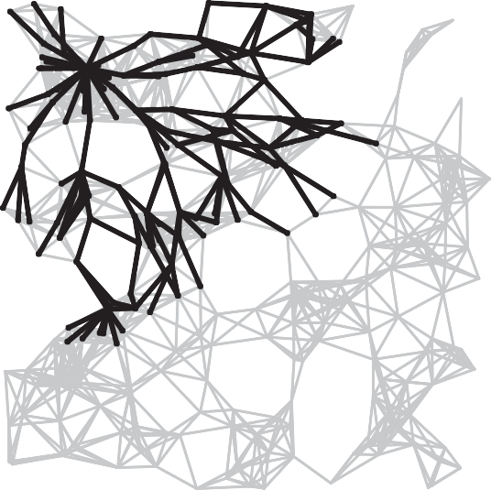
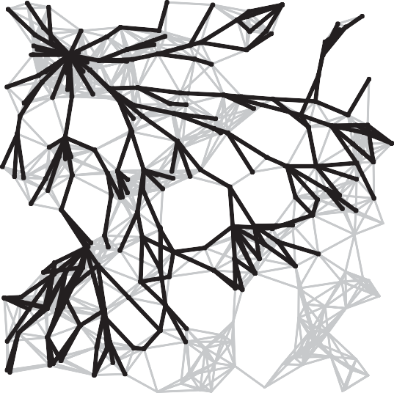
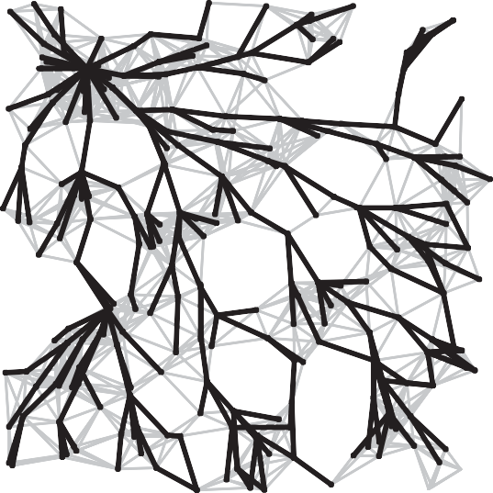
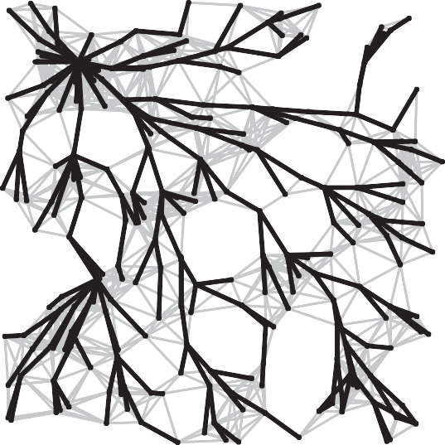
Bellman-Ford Algorithm Visualization
passes 4
7
10
13
SPT

Slide 29
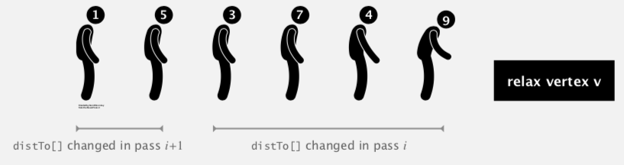
Bellman-Ford Algorithm Analysis
Observation. If distTo[v] does not change during pass i, no need to relax any edge pointing from v in pass i + 1.
In the worst case, the running time is still proportional to E × V. But much faster in practice.
Queue-based implementation of Bellman–Ford. Maintain queue of vertices whose distTo[ ] values needs updating.
be careful to keep at most one copy of each vertex on queue
Observation. If there is a negative cycle, Bellman-Ford gets stuck in loop, updating distTo[ ] and edgeTo[ ] entries of vertices in the cycle.
Proposition. If any vertex v is updated in phase V, there exists a negative cycle (and can trace back edgeTo[v] entries to find it).
Finding a negative cycle

Slide 30

Negative Cycle Application: Arbitrage Detection
Problem. Given table of exchange rates, is there an arbitrage opportunity?
 | USD | EUR | GBP | CHF | CAD
USD | 1 | 0.741 | 0.657 | 1.061 | 1.011
EUR | 1.350 | 1 | 0.888 | 1.433 | 1.366
GBP | 1.521 | 1.126 | 1 | 1.614 | 1.538
CHF | 0.943 | 0.698 | 0.620 | 1 | 0.953
CAD | 0.995 | 0.732 | 0.650 | 1.049 | 1
Ex. $1,000 ⇒ 741 Euros
⇒ 1,012.206 Canadian dollars
⇒ $1,007.14497.
1000 × 0.741 × 1.366 × 0.995 = 1007.14497

Slide 31



Negative Cycle Application: Arbitrage Detection
Currency exchange graph.
Vertex = currency.
Edge = transaction, with weight equal to exchange rate.
Find a directed cycle whose product of edge weights is > 1.
Challenge. Express as a negative cycle detection problem.
-ln(.741) -ln(1.366) -ln(.995)
Remark. Fastest algorithm is extraordinarily valuable!
0.741 * 1.366 * .995
= 1.00714497
EUR
.2998 - .3119 + .0050
= -.0071
EUR
1.350
0.888
-.3001
.1188
0.741
1.366
1.433
.2998
-.3119
-.3598
1.126
-.1187
USD
0.657
GBP
_{USD} .4201
GBP
1.521
replace each weight w with -ln(w)
-.4914
1.061
-.0592
1.011
1.538
-.0109
-.4305
1.614
-.4787
0.995
0.732
0.698
0.620
.0050
.3120
.3595
.4780
0.650
.4308
1.049
0.943
-.0478
.0587
CAD
0.953
CHF
CAD
.0481
CHF
Model as a negative cycle detection problem by taking logs.
Let weight of edge v→w be - ln (exchange rate from currency v to w).
Multiplication turns to addition; > 1 turns to < 0.
Find a directed cycle whose sum of edge weights is < 0 (negative cycle).

Slide 32
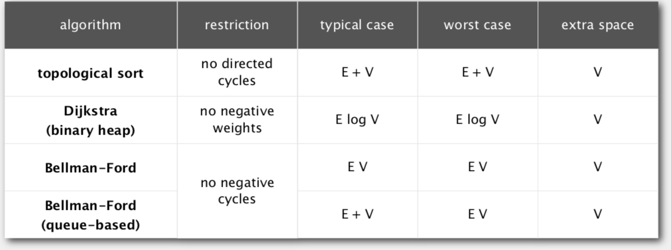
Single Source Shortest-paths Implementation: Cost Summary
Remark 1. Directed cycles make the problem harder.
Remark 2. Negative weights make the problem harder.
Remark 3. Negative cycles makes the problem intractable.

Slide 33
Backup Slides

Slide 34
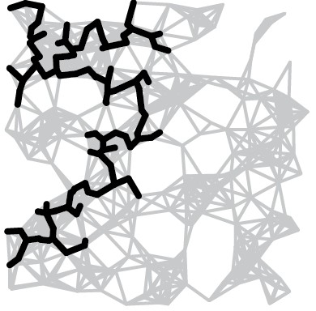
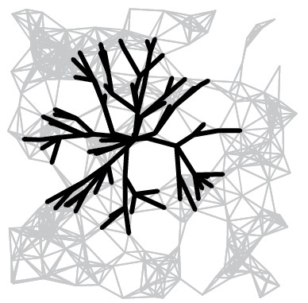
Dijkstra’s Algorithm Analysis
Dijkstra’s algorithm seem familiar?
Prim’s algorithm is essentially the same algorithm.
Both are in a family of algorithms that compute a graph’s spanning tree.
Main distinction: Rule used to choose next vertex for the tree.
Prim’s: Closest vertex to the tree (via an undirected edge).
Dijkstra’s: Closest vertex to the source (via a directed path).
Note: DFS and BFS are also in this family of algorithms.
O(E log V)
operation | frequency | time per op
Insert | E | log V
delete min | E | log V
decrease key | E | log V
Computing spanning trees in graphs

